Slide 1
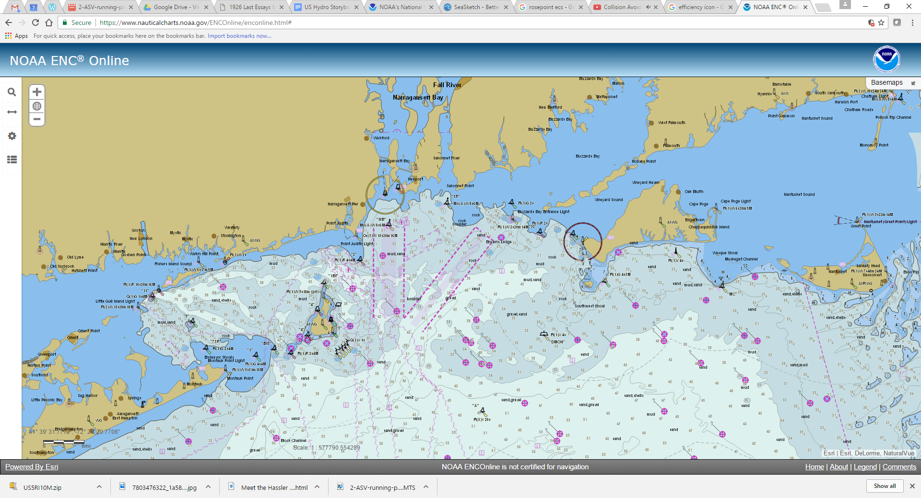
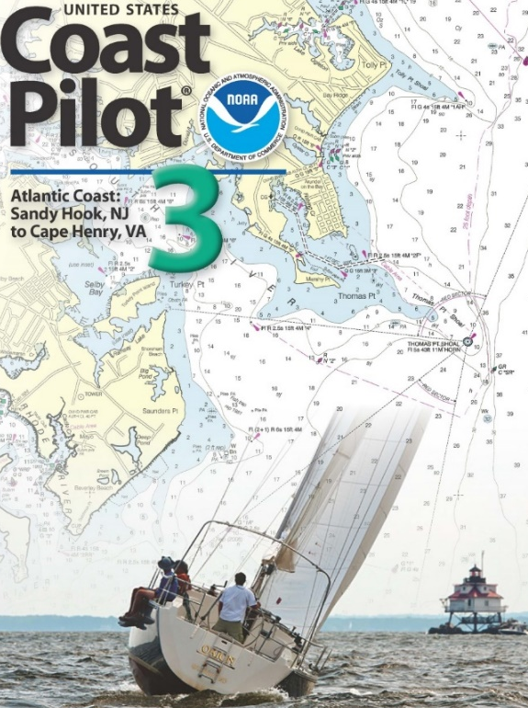

Coast Pilot
Strategy for moving forward
Recent observations
Tom Loeper
(301)367-5680
thomas.loeper@noaa.gov
^{Office of Coast Survey}
National Oceanic and Atmospheric Administration
Notes:
Sailing Directions go back thousands of years and they were really one of the first tools in a mariners navigation toolbox.
Predate mass-produced charts and magnetic compasses
We are part of a very long chain of SD providers that go back centuries but in the last decade or so, we have gone through some considerable changes.
Moving away from very traditional methods of compilation and production
electronic distribution
weekly updates
fulfilling carriage requirements with electronic documents
Print on Demand
Much, much more

Slide 2
Coast Pilot
Where are we now?
NIPWG work is moving as planned
We know we need to normalize or fix our data
We don’t really have the proper tools to start coding to our own standards
We may not have the proper skill sets
We don’t know if this will work in an ECDIS environment
^{Office of Coast Survey}
National Oceanic and Atmospheric Administration
Notes:
But we still have some challenges to overcome.

Slide 3
Coast Pilot
Inventory of what we have now.
Endorsement from our leadership to continue working
We do know about many of our data shortcomings and structure – our data holes
There are some automated tools available
We do have some portrayal schemes as a starting point
^{Office of Coast Survey}
National Oceanic and Atmospheric Administration

Slide 4
Coast Pilot
My orders are to. . .
Develop a new end-state for services to complement digital charts and electronic navigation. These services should include navigation regulations, safety-related navigation recommendations, and authoritative overlays for MPAs, NDZs, speed zones, and perhaps fisheries regulations. . .
^{Office of Coast Survey}
National Oceanic and Atmospheric Administration
Notes:
My boss – Admiral Smith – sent me a note a few weeks ago that I wanted share some sections with you that might be important to us as a group.
The idea is to “rejuvenate” Coast Pilot in the next 5 years and keep it relevant in the electronic age.

Slide 5
Coast Pilot
My orders are to (cont.). . .
. . . There should be no mention of chart numbers, since these are de-emphasized in electronic navigation. Since we have a really hard time maintaining information about specific facilities in ports, and users are successfully using other means to obtain this information, I would eliminate them.
^{Office of Coast Survey}
National Oceanic and Atmospheric Administration
Notes:
As a for instance, we have a very difficult time of updating information about port facilities.
Much of our information is over 10 years old and we have no way to systematically update the information around the U.S.

Slide 6
Coast Pilot
Several important points
Inventory the types of information that are in the current Coast Pilot.
Using Inquiry Management System and discussions within NOAA and mariners to identify information that is not currently well served in Coast Pilot, but which users need (No Discharge Zones, MPAs, speed zones, fisheries regulations, etc)
^{Office of Coast Survey}
National Oceanic and Atmospheric Administration

Slide 7
Coast Pilot
Several important points (cont.)
Identify mechanisms for dissemination of this information (in the chart, as an S-10X overlay, as a non-S-10X overlay, as a web service, in a book).
Match up types of information to available dissemination mechanisms.
^{Office of Coast Survey}
National Oceanic and Atmospheric Administration

Slide 8
Coast Pilot
Several important points (cont.)
Develop a plan for “next-generation Coast Pilot” that is a collection of authoritative overlays, web services, and publications. This plan will be disseminated for public comment.
Develop a “resourceable” implementation plan, that includes technology, staffing requirements, and a timeline for service transition. The new services should be fully in place by 2022.
^{Office of Coast Survey}
National Oceanic and Atmospheric Administration

Slide 9
Coast Pilot
Timelines
The final approved plan should be published NLT Feb 1, 2019.
The implementation plan can be drafted concurrently with public review.
We can begin to resource the transition and new services once we have an initial draft of the implementation plan.
^{Office of Coast Survey}
National Oceanic and Atmospheric Administration

Slide 10
Coast Pilot
What can NIPWG learn from this?
SD’s are still important to the Mariner
Want to devote time, energy and resources
Our work has a high profile and it is valuable
Demanding some results
^{Office of Coast Survey}
National Oceanic and Atmospheric Administration
Notes:
My Boss wants to see some tangible results
My Boss is talking to your Boss
Your Boss may be asking you the same questions

Slide 11
Coast Pilot
Looking ahead.
Maintain information that is to some extent readable by humans
Transform current information in a machine readable format
More automation on ships
Eventually autonomous ship
^{Office of Coast Survey}
National Oceanic and Atmospheric Administration

Slide 12
Coast Pilot
Strategies for how do we get there?
Leverage completed work
Work from Wilford, Briana, Korea and Anthropocene Institute
Take some small first steps
Inventory your information
Make a list of priorities
Remove information when and if possible
^{Office of Coast Survey}
National Oceanic and Atmospheric Administration

Slide 13
Coast Pilot
Strategies for how do we get there? (cont.)
Try to work on web services
Work on some authoritative overlays
Consider non-regulated mariners
We know surveys are difficult to create and results can be misleading
Use these mariners as your test subjects.
^{Office of Coast Survey}
National Oceanic and Atmospheric Administration

Slide 14
Coast Pilot
Tom Loeper
(301)367-5680
thomas.loeper@noaa.gov
coast.pilot@noaa.gov
^{Office of Coast Survey}
National Oceanic and Atmospheric Administration

